Slide 1
Collaborative Filtering Recommendation System with Apache Spark using Scala
Presented By
Supriya Majjagi
Ritvik Chauhan

Slide 2
Use Case
Providing the relevant information out of irrelevant and relevant content(ratings) given by users.
Movie Recommendation System aims to recommend movies to users based on user ratings (item).

Slide 3
Dataset
It is 20M dataset provided on about 27278 movies
There are 4 types of data files – Ratings, Movies, User and Tag
Ratings :- Userid:Movieid:Rating:Timestamp
User :-Userid:Gender:Age:Occupation:Zip-code
Movie:-Movieid:Title:Generes
Tag :- Userid:Movieid:Tag:Timestamp

Slide 4
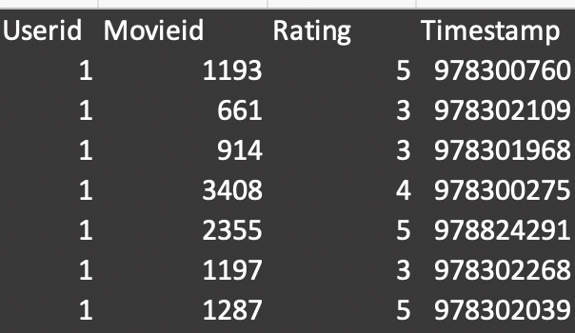
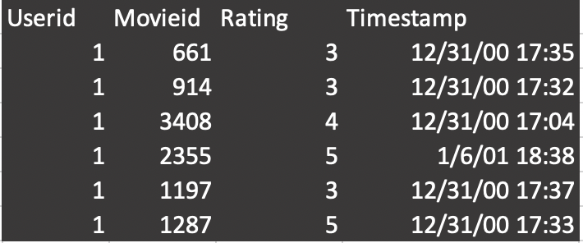
Data Preprocessing
The null values have been removed from the file.
The Timestamp column of Rating file has been converted into Datetime type.

Slide 5
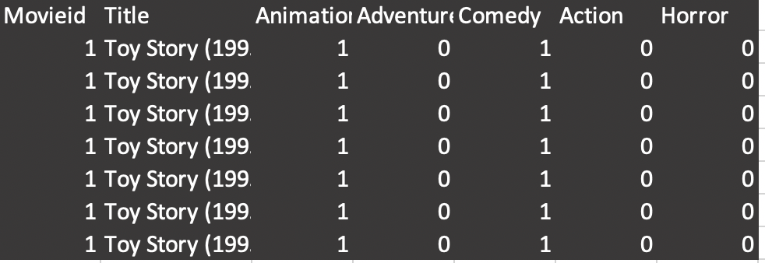
Data Preprocessing(Continued)
The genres in Movies file are separated and converted into matrix format.
Joined the files using Userid and Movieid.

Slide 6
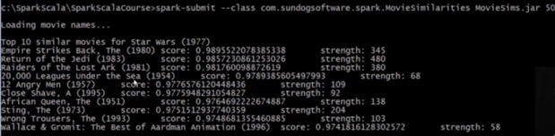
Acceptance Criteria
Recommending movies based on his/her ratings.
RMSE = 0.4365 <1

Slide 7
Data Exploration
Ratings by Age and Gender.

Slide 8
Data Exploration(Continued)
Correlation between the genres.

Slide 9
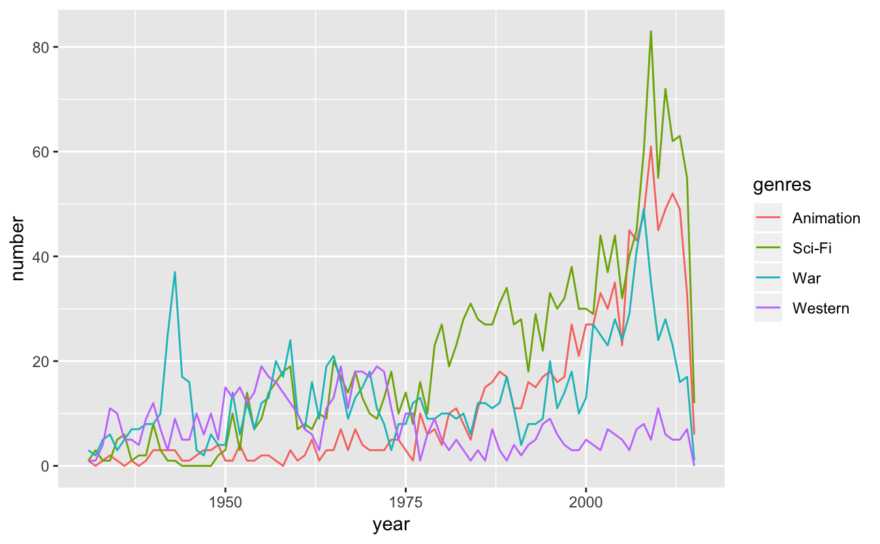
Analyzation of different genres across year

Slide 10
Recommendation System(Code Overview)
Creation of tuple – (user_id,(Movie_id,rating))
Finding the movie pair rated by the same user
New tuple - ((movieId1, movieId2), (rating1, rating2))
Apply cosine similarity on the rating vector

Slide 11
Conclusion
As user behavior changes with time the accuracy of this techniques varies time to time
Apache Spark is a great tool to implement features like this

Slide 12

Thank You

Slide 13
Questions?

